Slide 1




Navigating the Future: Deep Learning for Advanced Object Recognition
Christian Ingul
Aditya Dhanotia
Anthony Navarro
Sharon Lu

Slide 2
Agenda
01
03
02
04
Problem Statement
Model Building
How can advanced object recognition improve our daily life?
Creating object detection model, evaluating the performance, and making predictions
Data Preprocessing
Challenges & Next Steps
Collecting data and building the preprocessing pipelines
What were our challenges? How could we improve our solution?

Slide 3
01
Problem Statement
How to improve our daily life using advanced object recognition?

Slide 4

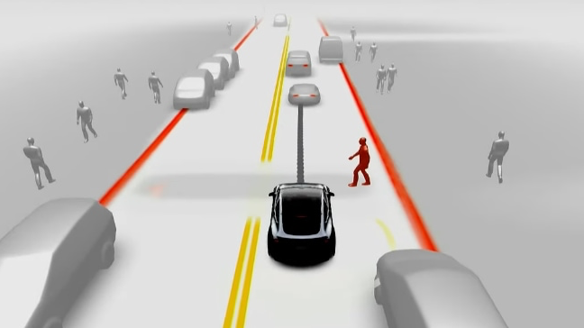

Purpose
Problem Statement
Data Preprocessing
Model Building
Challenges & Next Steps
Common Applications
Our Project Goal
Autonomous Vehicles
Smart Retail
Access Control & Check-in
Use face recognition to eliminate the cons of using employee badges

Slide 5
Background of Object Recognition
Problem Statement
Data Preprocessing
Model Building
Challenges & Next Steps
1
2
3
Feature Extraction & Model Training
Validation & Optimization
Inference & Deployment
After preprocessing images or videos, use Machine Learning algorithms to learn patterns and correlations
Fine-tuning and optimization techniques are applied to improve the model's performance and recognition capabilities
The optimized model is used for inference, processing new input to accurately recognize and categorize objects

Slide 6

02
Data Preprocessing
In TensorFlow
Notes:
3 - 3.5 mins per person

Slide 7




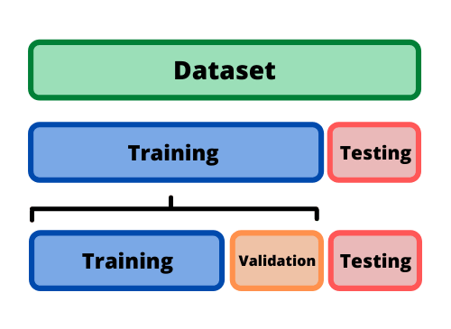
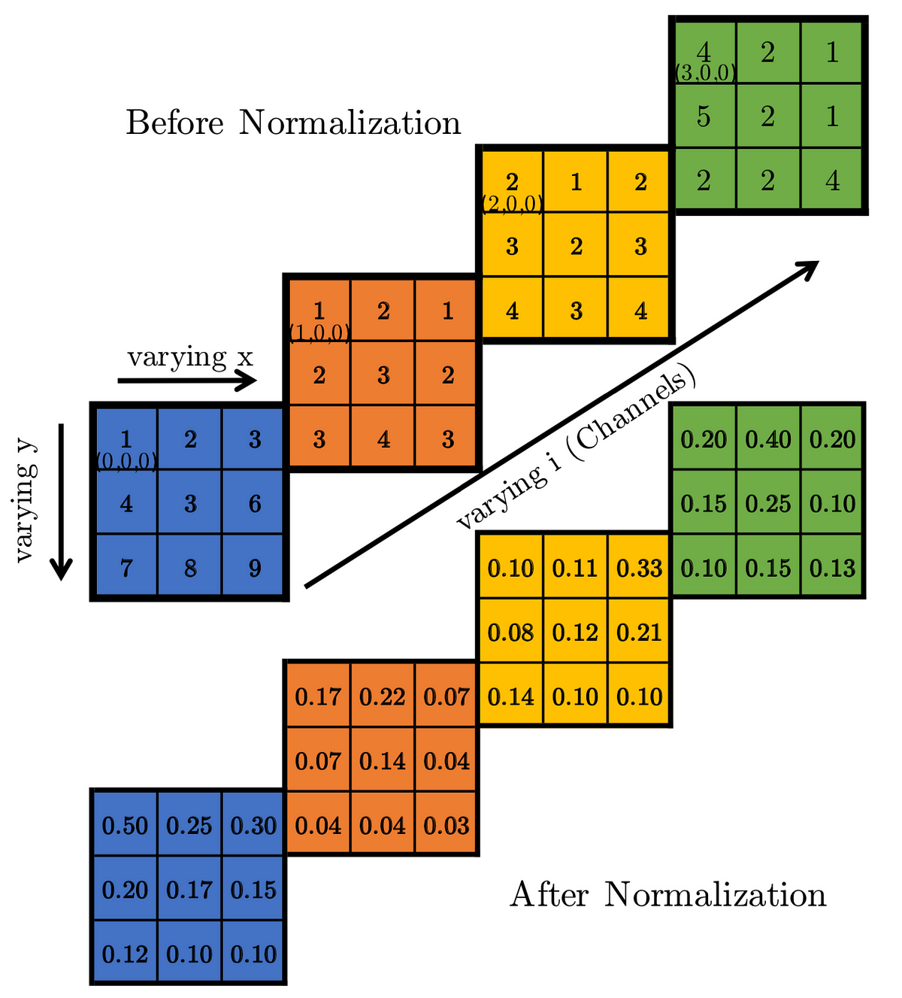
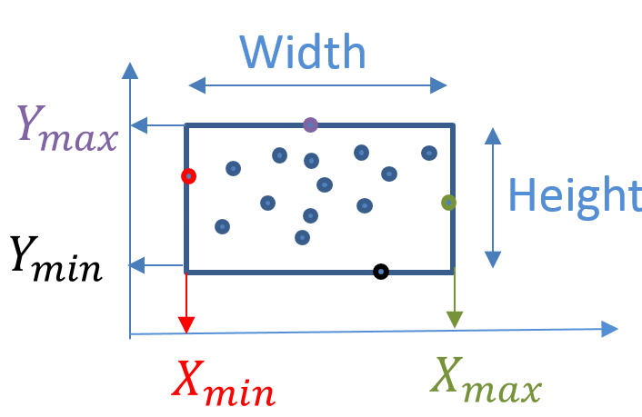
Preprocessing Pipeline
Problem Statement
Data Preprocessing
Model Building
Challenges & Next Steps
Capturing Images
Labeling Images
Data Augmentation
Image Resizing
Normalization
Labels & Images
4200 Train 900 Val
840 Test

Slide 8
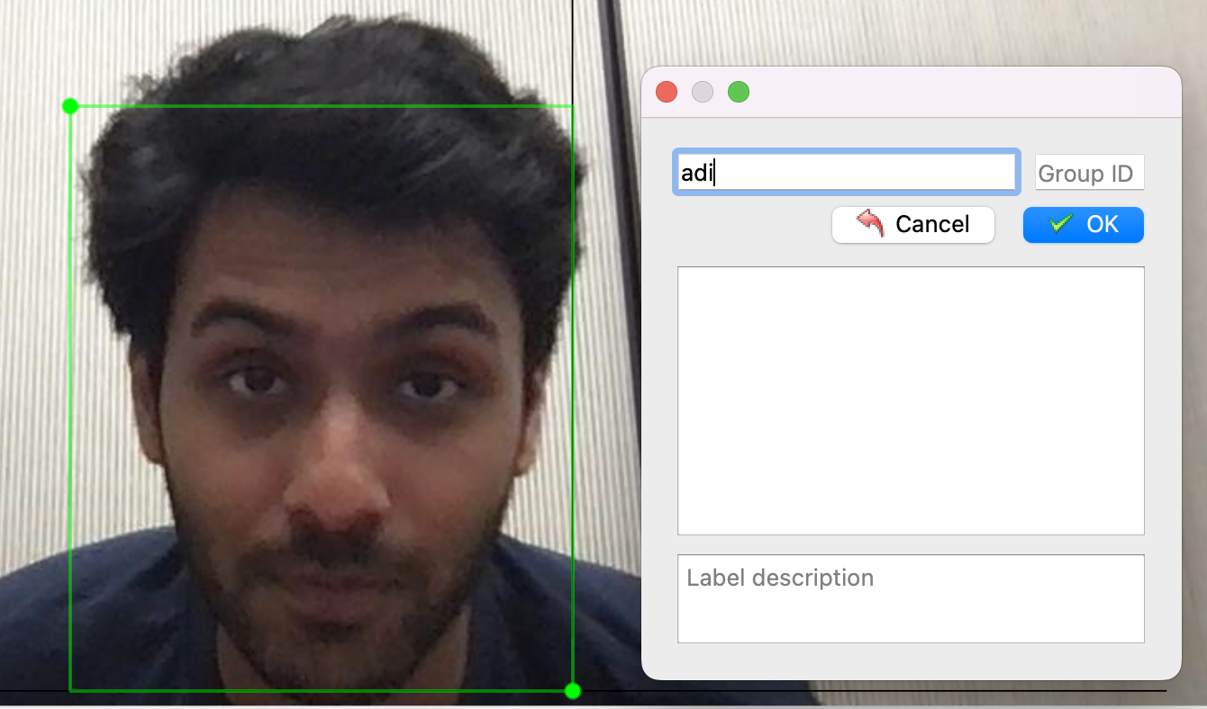
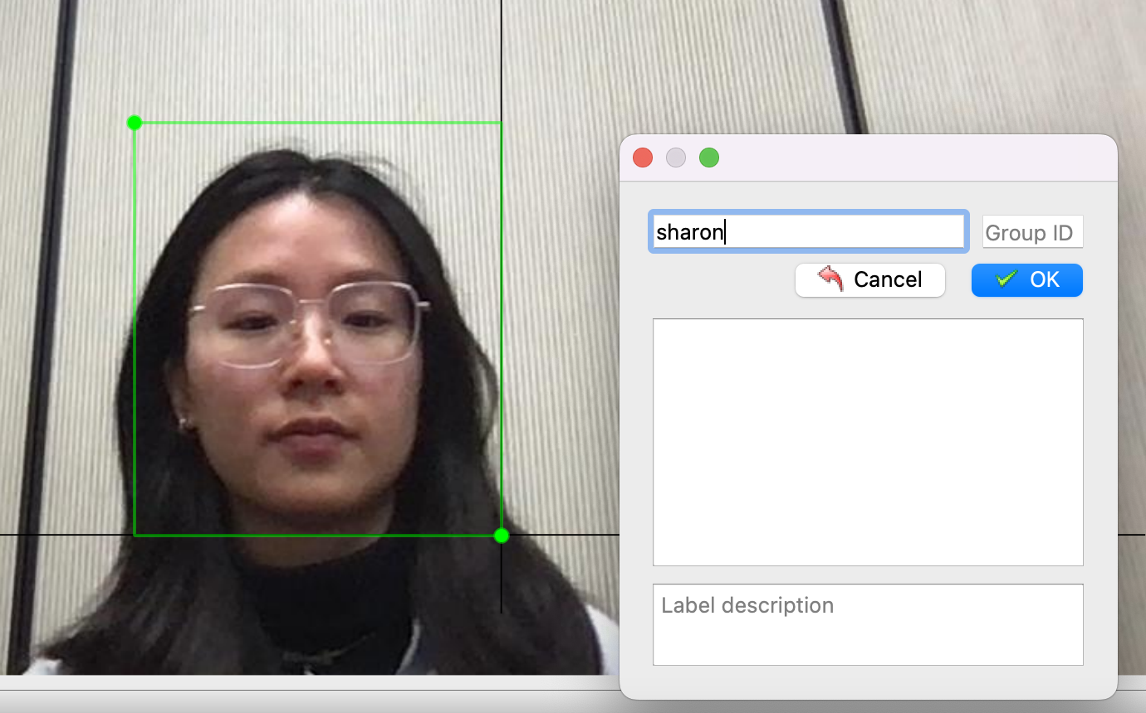

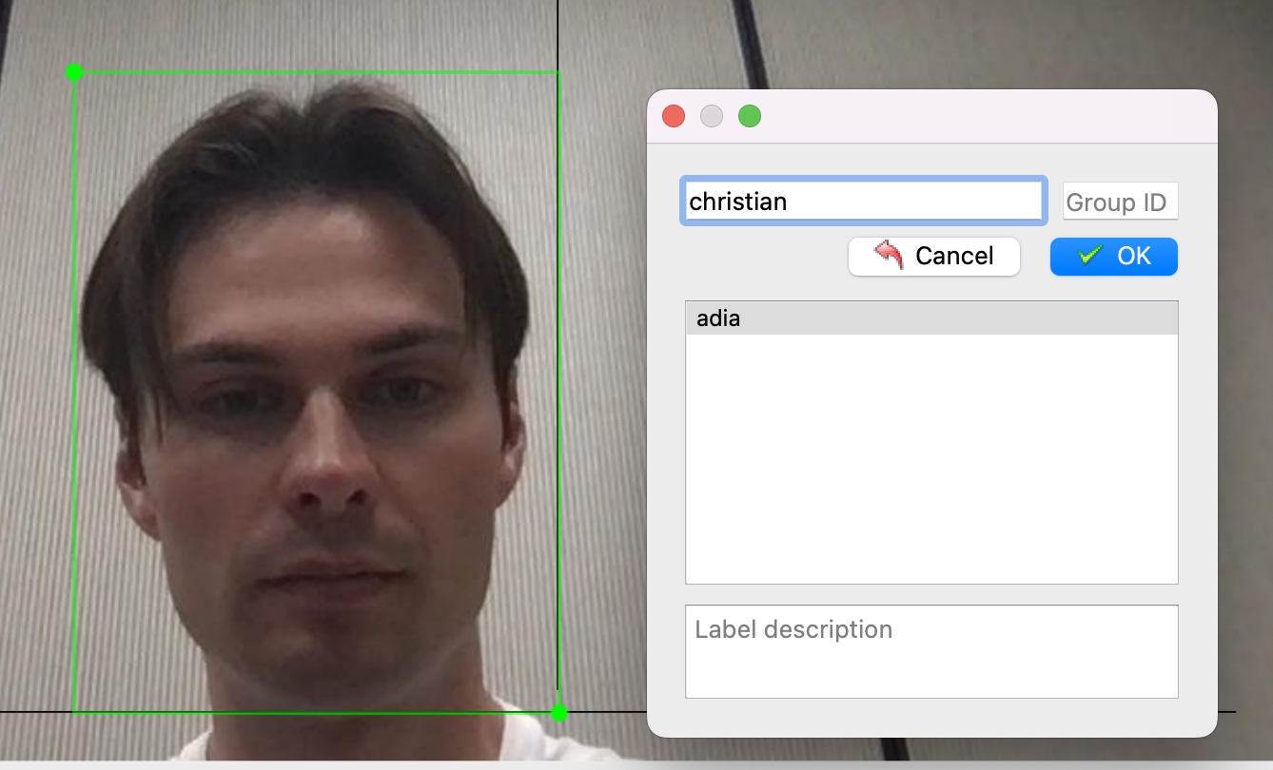

Generating and Labeling Data
Problem Statement
Data Preprocessing
Model Building
Challenges & Next Steps
Packages Used
99 images | 4 classes: Adi, Sharon, Christian & No Face

Slide 9
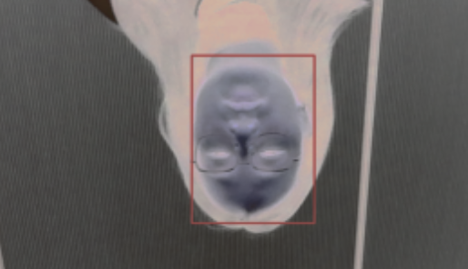

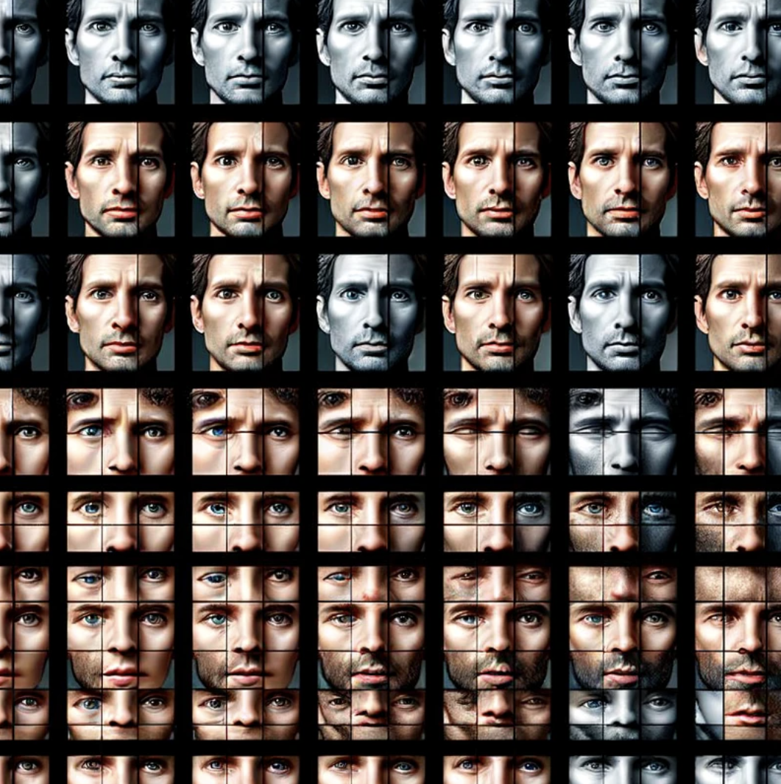

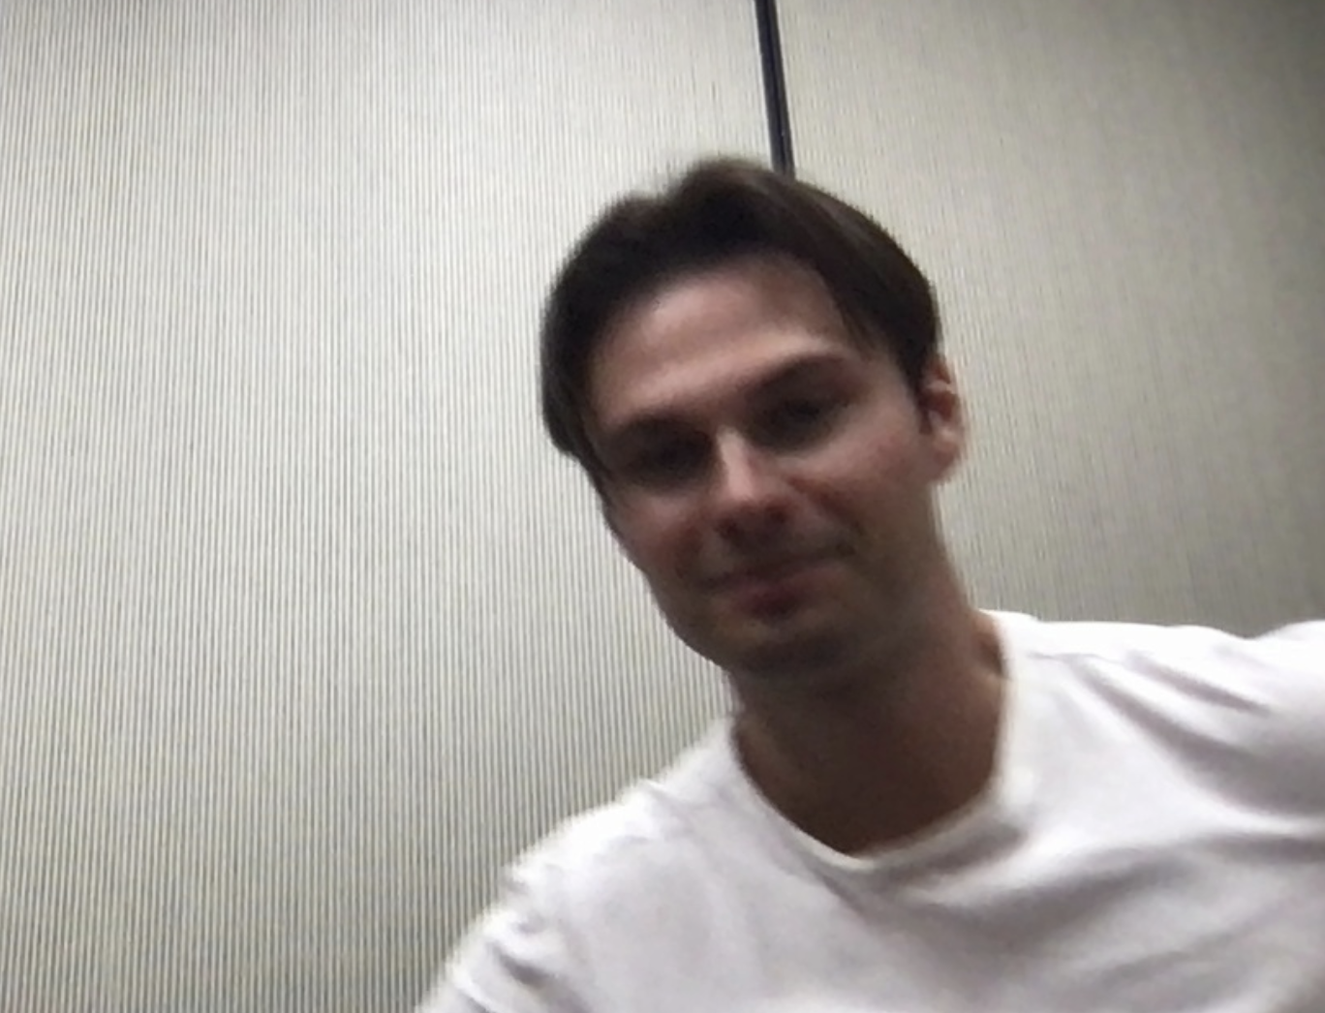

Data Augmentation
Problem Statement
Data Preprocessing
Model Building
Challenges & Next Steps
Random Brightness
Vertical Flip
Each image is Augmented 60 times
Horizontal Flip
Random Gamma
New total of 5940 Images!

Slide 10

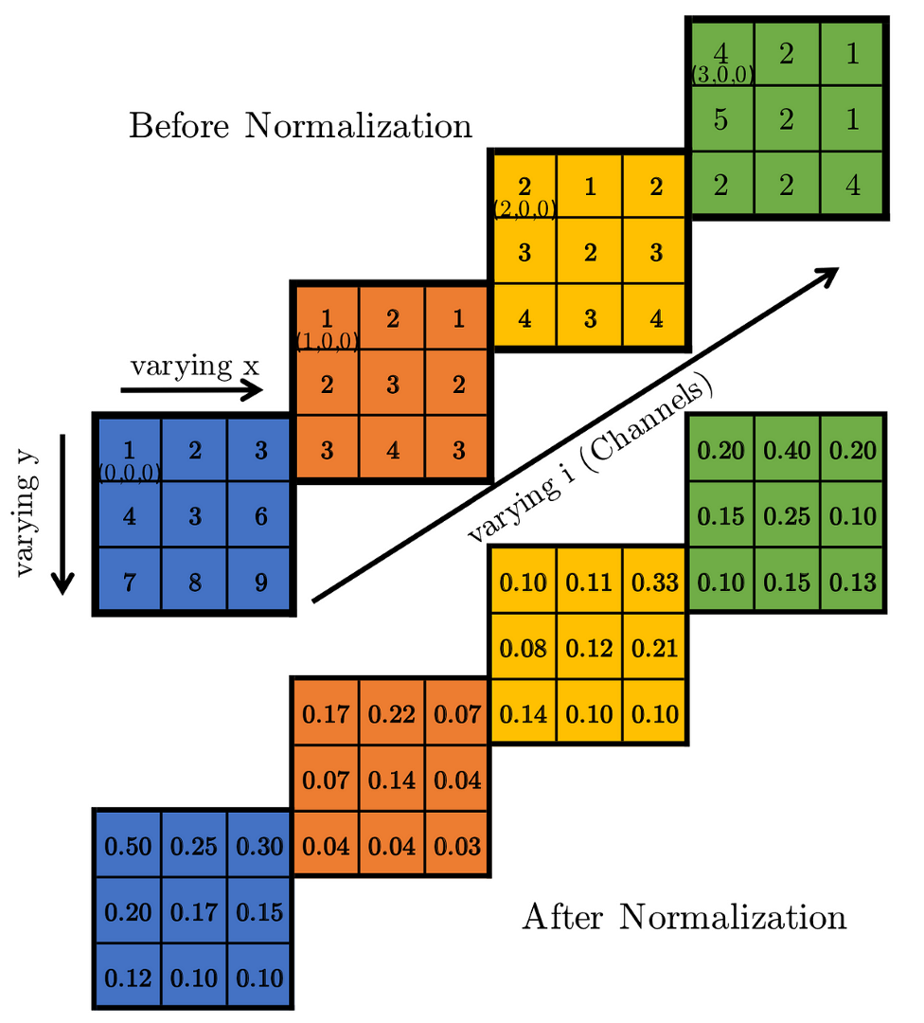
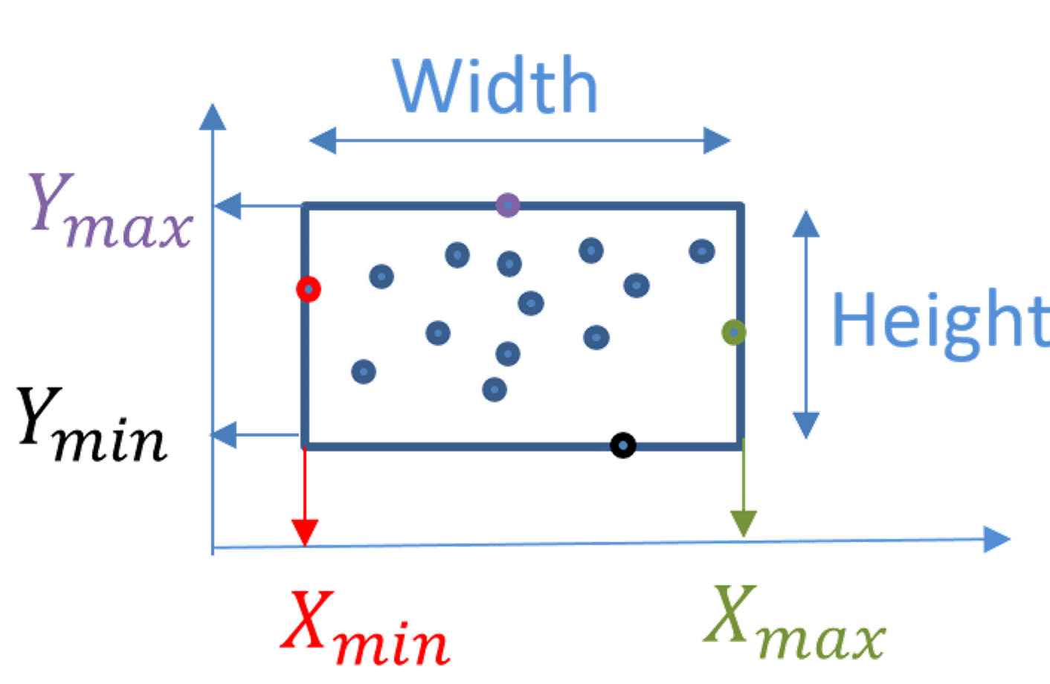
Dimensionality Reduction & Normalization
Problem Statement
Data Preprocessing
Model Building
Challenges & Next Steps
Resizing images to (224x224)
Dividing each pixel by 255
Normalizing Bounding Box Coordinates

Slide 11
03
Model Building
In TensorFlow

Slide 12
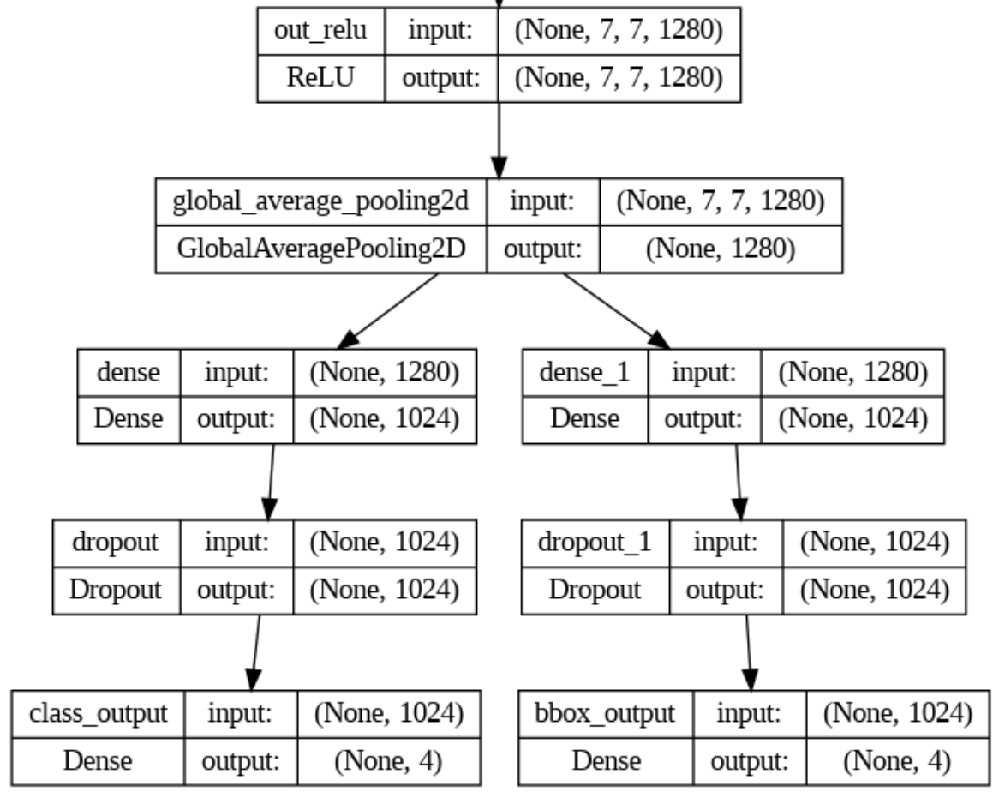
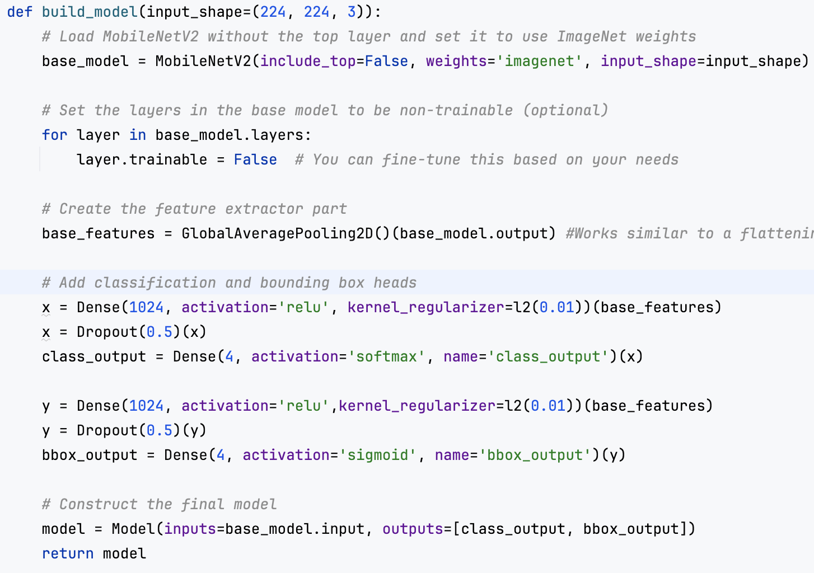
Model Architecture & Fine-Tuning
Problem Statement
Data Preprocessing
Model Building
Challenges & Next Steps
New MobileNetv2 Architecture
Key Modeling Decisions

Slide 13
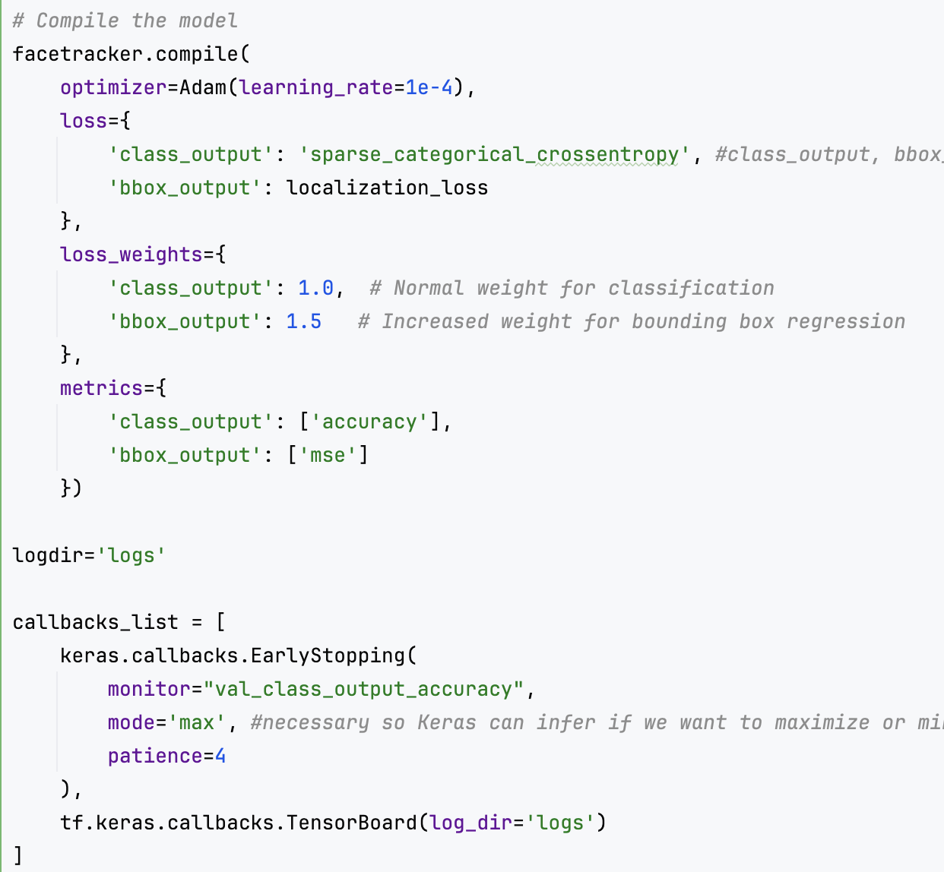
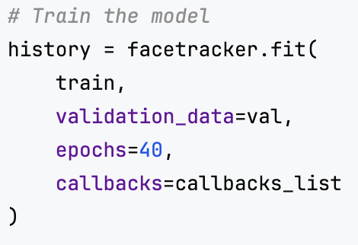
Optimizer, Loss, Training Performance
Problem Statement
Data Preprocessing
Model Building
Challenges & Next Steps
Model Compiling
Model Training
Ran for a total of 10 epochs

Slide 14
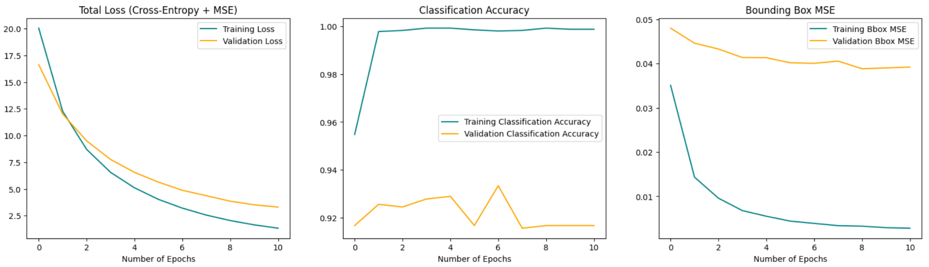
Training and Validation Performance
Problem Statement
Data Preprocessing
Model Building
Challenges & Next Steps
Total Loss
Classification Accuracy
Bounding Box MSE

Slide 15
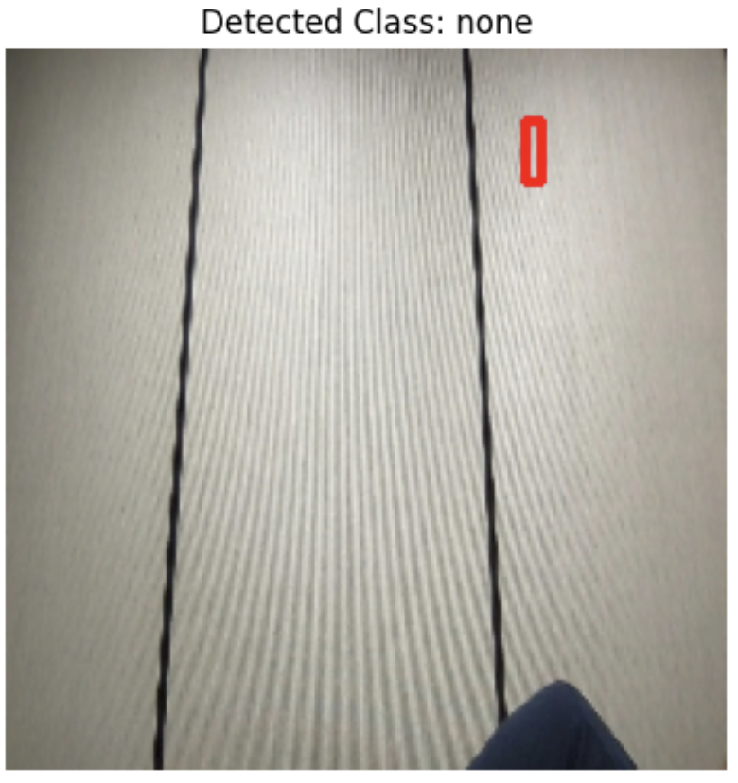
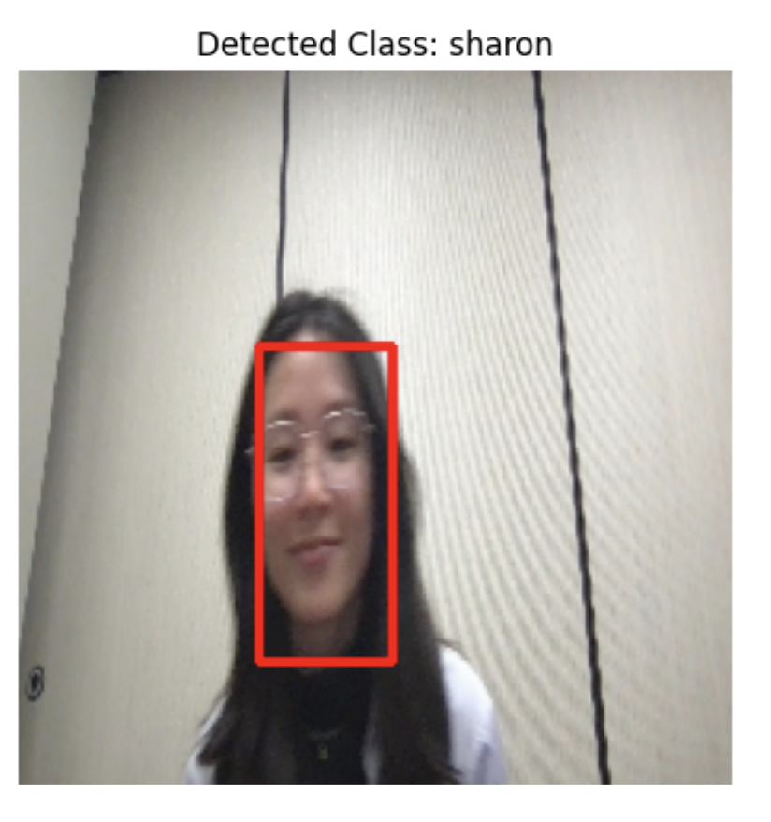
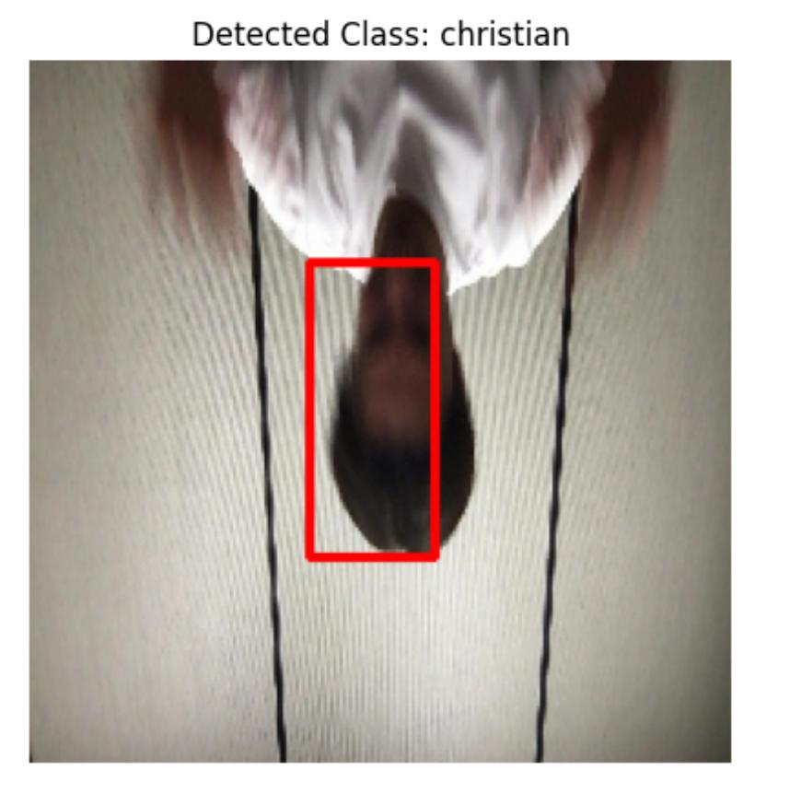
Predicting on the Test Set
Problem Statement
Data Preprocessing
Model Building
Challenges & Next Steps
Classification Accuracy
Total Loss
Bounding Box MSE
99%
1.88
0.018

Slide 16
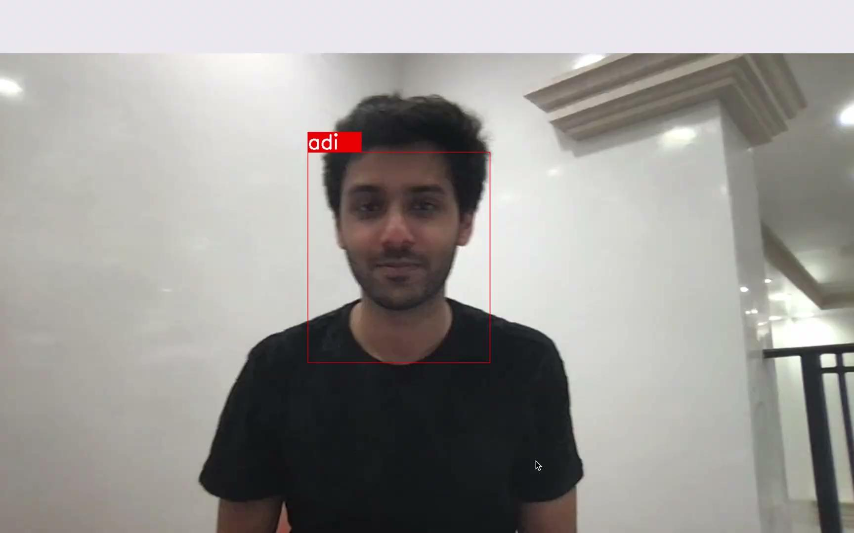
Demo of Model Real-Time Prediction
Problem Statement
Data Preprocessing
Model Building
Challenges & Next Steps

Slide 17
04
Challenges & Next Steps

Slide 18
Future Study
Problem Statement
Data Preprocessing
Model Building
Challenges & Next Steps
Challenges
Next Steps
Manual Labeling
A
B
Automating Labeling
Computationally Expensive
C
D
Switch to GPU
Challenges of Deep Learning
Data Augmentation
E
F
More Diverse Augmentation
Model Architecture
G
H
Explore More Advanced Models

Slide 19
Thank You!

